Slide 1

TENSORFLOW 2.0
PRACTICAL ADVANCED

Slide 2

AUTOENCODERS

Slide 3
AUTOENCODERS INTUITION

Slide 4
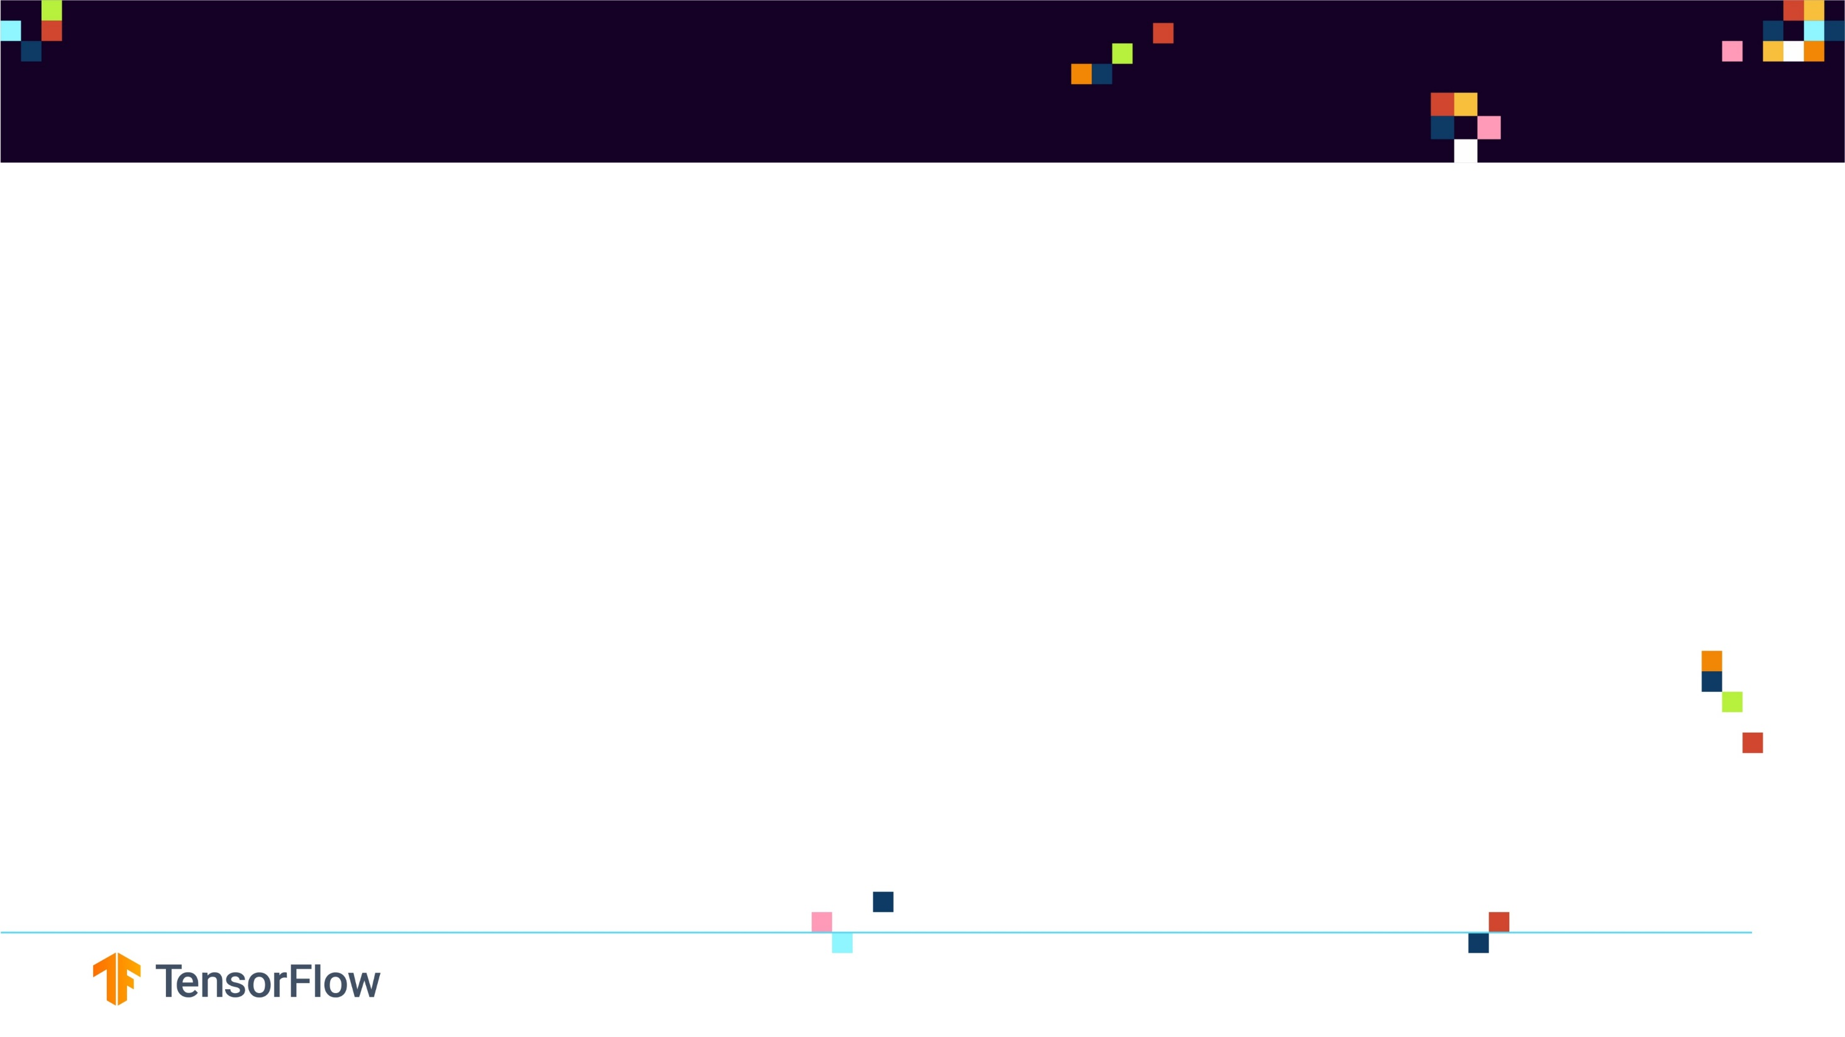
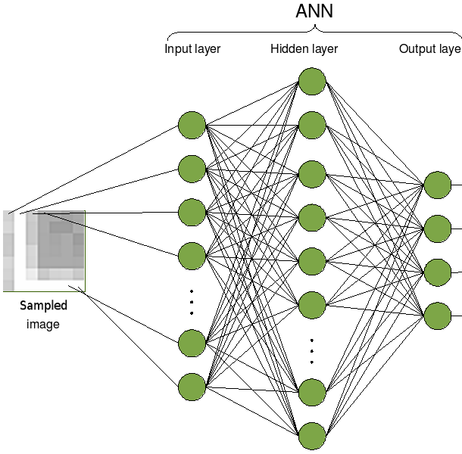
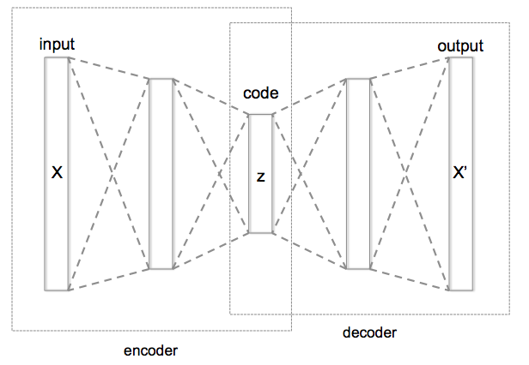
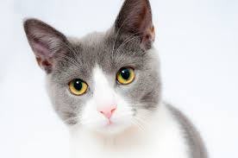
AUTOENCODERS INTUITION
Auto encoders are a type of Artificial Neural Networks that are used to perform a task of data encoding (representation learning).
Auto encoders use the same input data for the input and output, Sounds crazy right!?
TRADITIONAL FEED-FORWARD ANN
SUPERVISED TRAINING
AUTOENCODERS UNSUPERVISED
TRAINING
TARGET (TRUE)
LABEL = CAT
ENCODED CAT IMAGE
Photo Credit: https://commons.wikimedia.org/wiki/File:Autoencoder_structure.png
Photo Credit: https://commons.wikimedia.org/wiki/File:Artificial_neural_network_image_recognition.png
Photo Credit: https://www.pexels.com/photo/grey-and-white-short-fur-cat-104827/

Slide 5
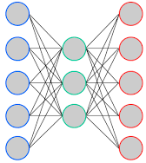
THE CODE LAYER
Auto encoders work by adding a bottleneck in the network.
This bottleneck forces the network to create a compressed (encoded) version of the original input
Auto encoders work well if correlations exists between input data (performs poorly if the all input data is independent)
Great Reference: “Intro to Auto encoders by Jeremy Jordan”
BOTTLENECK
“CODE LAYER”
(i.e.: ENCODED CAT IMAGE)
ENCODER
DECODER
Photo Credit: https://commons.wikimedia.org/wiki/File:Autoencoder_structure.png
Photo Credit: https://commons.wikimedia.org/wiki/File:Artificial_neural_network_image_recognition.png
Photo Credit: https://www.pexels.com/photo/grey-and-white-short-fur-cat-104827/

Slide 6
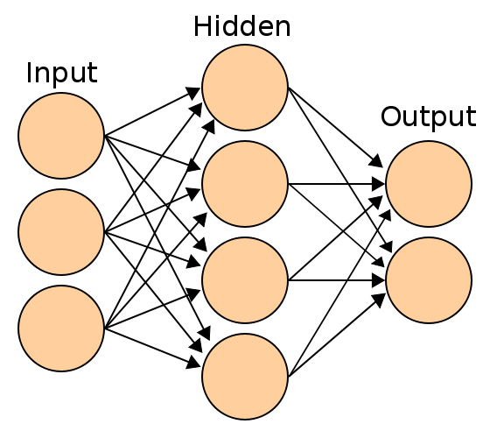
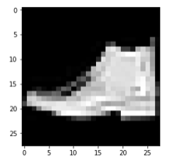
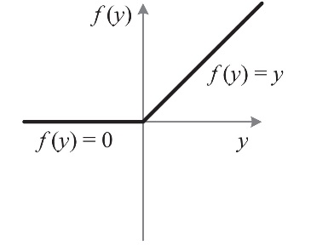
WE HAVE ALREADY ENCODED IMAGES IN THE PAST!
CNNs performs encoding by taking the feature detectors and converting them into a compact single dimensional output (which is fed to the fully connected Dense network).
CONVOLUTION
POOLING
FLATTENING
KERNELS/
FEATURE DETECTORS
POOLING FILTERS
ENCODED VERSION
CONVOLUTIONAL LAYER
POOLING LAYER (DOWNSAMPLING)
Photo Credit: https://commons.wikimedia.org/wiki/File:Artificial_neural_network.svg

Slide 7
AUTOENCODERS
MATHEMATICS

Slide 8
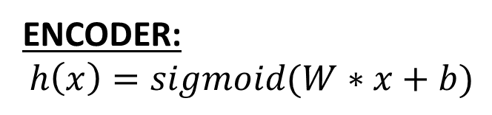


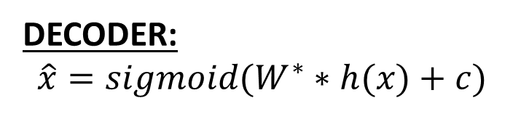
AUTOENCODER MATH
W
W*
ENCODER:
$$h\left(x\right)=sigmoid(W∗x+b)$$
x
$$\hat{x}$$
DECODER:
$$\hat{x}=sigmoid(W^{∗}∗h(x)+c)$$
TIED WEIGHTS:
Weights from input to hidden layer will be equal to the weights from hidden layer to output
$$W^{∗}=W^{T}$$
h(x)
ENCODER
DECODER
Photo Credit: https://commons.wikimedia.org/wiki/File:Autoencoder_structure.png
Photo Credit: https://commons.wikimedia.org/wiki/File:Artificial_neural_network_image_recognition.png
Photo Credit: https://www.pexels.com/photo/grey-and-white-short-fur-cat-104827/

Slide 9


RECONSTRUCTION ERROR
Auto encoders objective is to minimize the reconstruction error which is the difference between the input X and the network output $\hat{X}$
Auto encoders dimensionality reduction (latent space) is quite similar to PCA (Principal Component Analysis) if linear activation functions are used
X
$$\hat{X}$$
X
RECONSTRUCTION ERROR
ENCODER
DECODER
Photo Credit: https://commons.wikimedia.org/wiki/File:Autoencoder_structure.png
Photo Credit: https://commons.wikimedia.org/wiki/File:Artificial_neural_network_image_recognition.png
Photo Credit: https://www.pexels.com/photo/grey-and-white-short-fur-cat-104827/

Slide 10
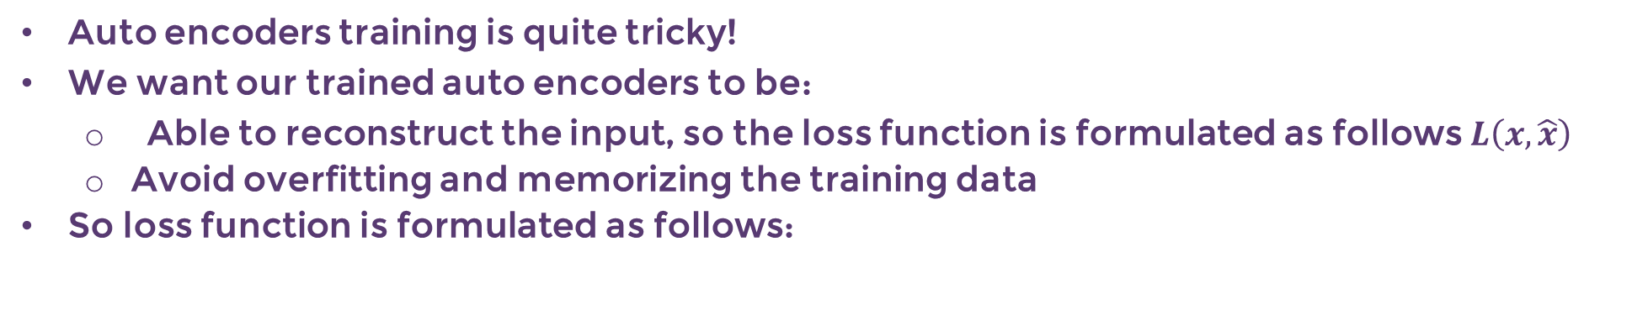
TRADE-OFF/DILEMMA!
Auto encoders training is quite tricky!
We want our trained auto encoders to be:
Able to reconstruct the input, so the loss function is formulated as follows $L\left(x,\hat{x}\right)$
Avoid overfitting and memorizing the training data
So loss function is formulated as follows:
$$Loss Function=L\left(x,\hat{x}\right)+Regularization Term$$
TO ENABLE INPUT RECONSTRUCTION
TO AVOID OVERFITTING AND MEMORIZING DATA
(IMPROVE GENERALIZATION)
Photo Credit: https://commons.wikimedia.org/wiki/File:Autoencoder_structure.png
Photo Credit: https://commons.wikimedia.org/wiki/File:Artificial_neural_network_image_recognition.png
Photo Credit: https://www.pexels.com/photo/grey-and-white-short-fur-cat-104827/

Slide 11
AUTOENCODERS
VS. PCA

Slide 12
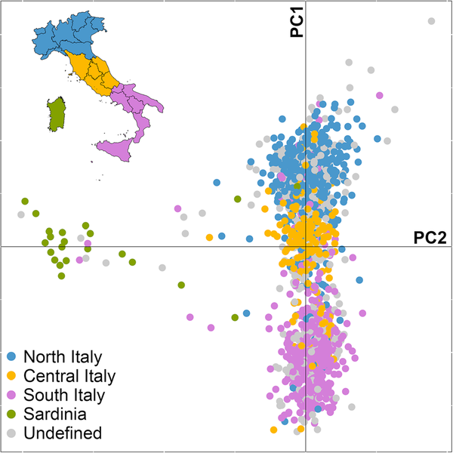
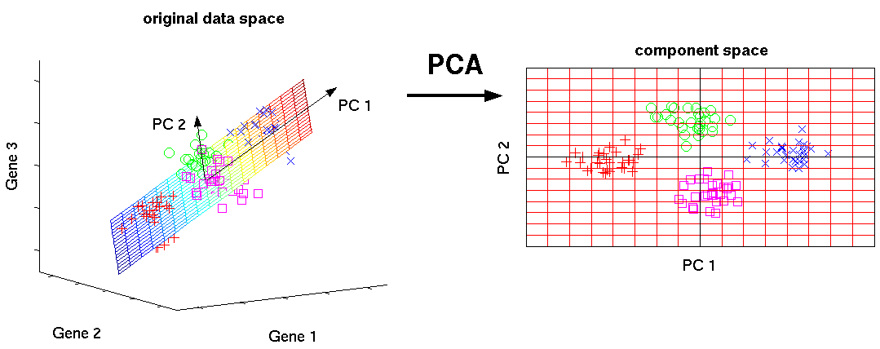
PRINCIPAL COMPONENT ANALYSIS EXAMPLE
Auto encoders dimensionality reduction is quite similar to PCA (Principal Component Analysis) if linear activation functions are used
Photo Credit: https://commons.wikimedia.org/wiki/File:Principal_Component_Analysis_of_the_Italian_population.png
Photo Credit: http://phdthesis-bioinformatics-maxplanckinstitute-molecularplantphys.matthias-scholz.de/

Slide 13
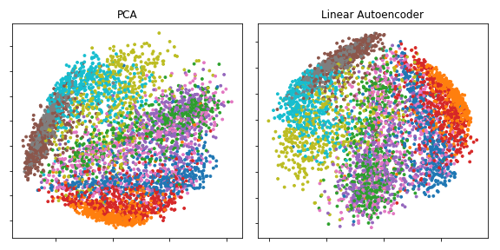
PRINCIPAL COMPONENT ANALYSIS EXAMPLE
Auto encoders dimensionality reduction is quite similar to PCA (Principal Component Analysis) if linear activation functions are used
Photo Credit: https://commons.wikimedia.org/wiki/File:PCA_vs_Linear_Autoencoder.png

Slide 14
AUTOENCODERS
APPLICATIONS

Slide 15
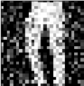
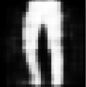
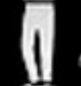
APPLICATION #1 - DENOISING AUTOENCODERS
One widely used application of Auto encoders is to perform de-noising!
Instead of feeding in the exact same data as the input and output
We will feed in a noisy image and then set the target to be the original image
NOISY INPUT
RECONSTRUCTED MODEL PREDICTIONS
TARGET OUTPUT
ENCODER
DECODER
Photo Credit: https://commons.wikimedia.org/wiki/File:Autoencoder_structure.png
Photo Credit: https://commons.wikimedia.org/wiki/File:Artificial_neural_network_image_recognition.png
Photo Credit: https://www.pexels.com/photo/grey-and-white-short-fur-cat-104827/

Slide 16
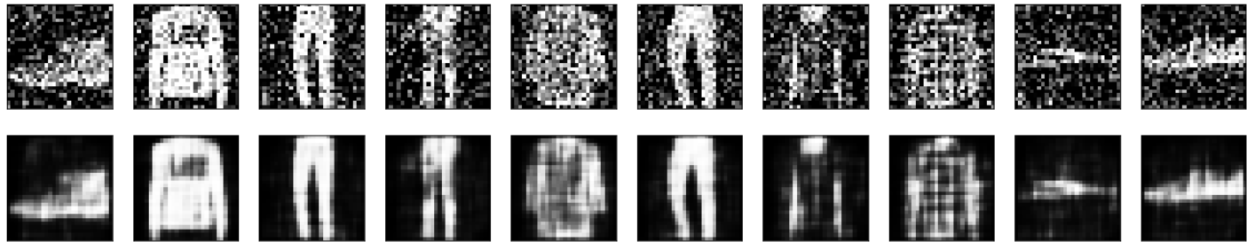
APPLICATION #1 - DENOISING AUTOENCODERS

Slide 17
APPLICATION #2 – IMAGE COMPRESSION
ORIGINAL DATA
(ENCODER)
COMPRESSED (ENCODED DATA)
RECONSTRUCTED ORIGINAL DATA
(DECODER)

Slide 18
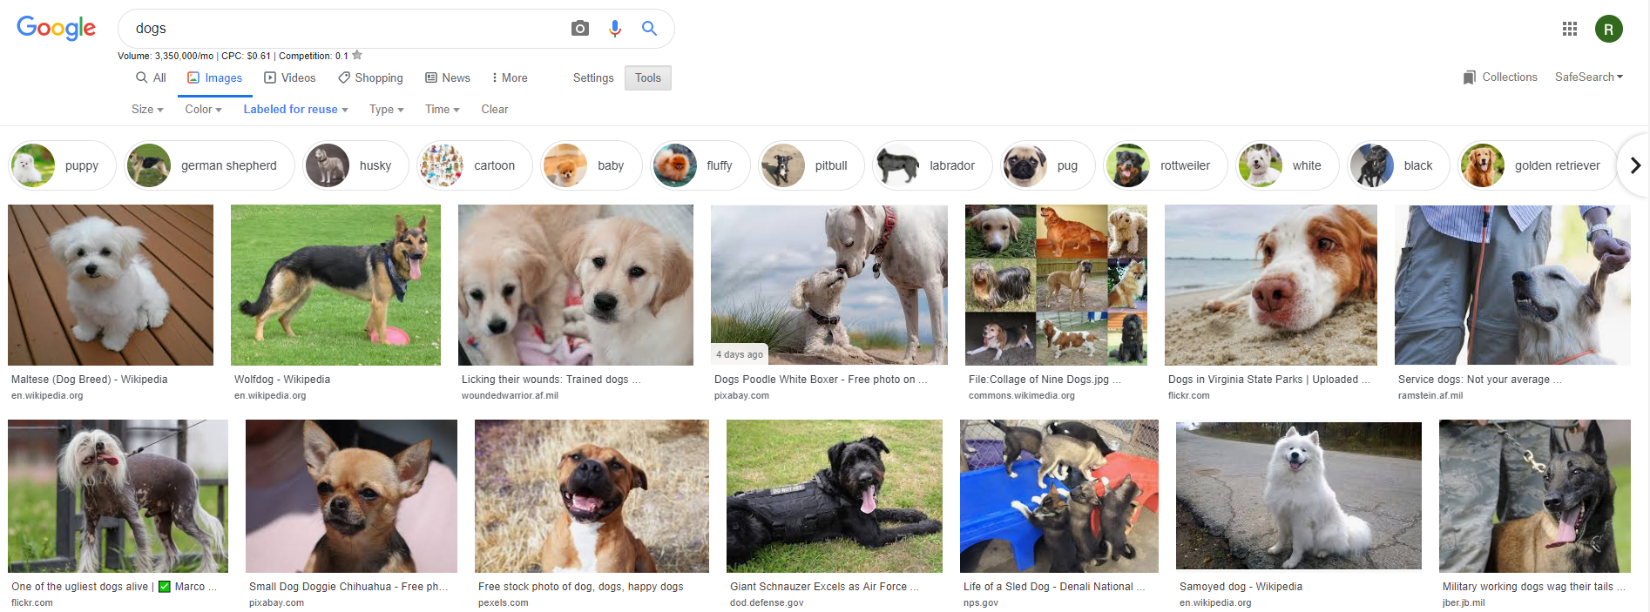
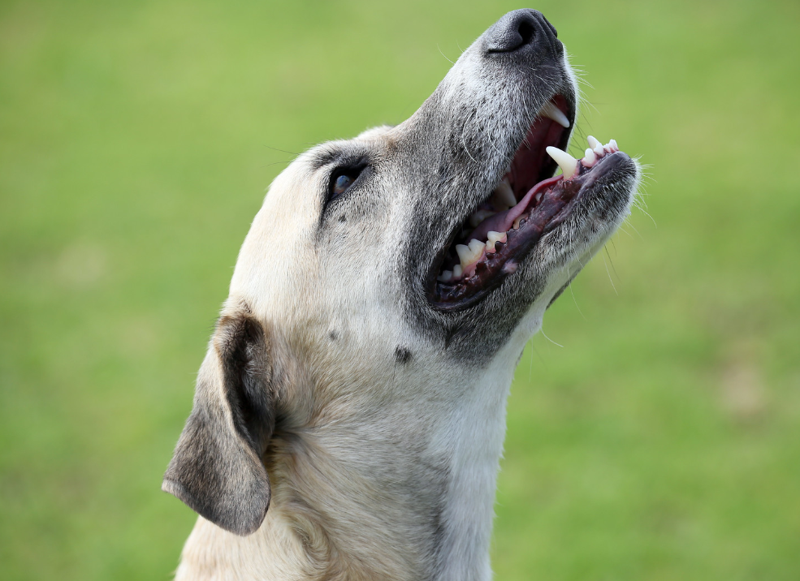

APPLICATION #3 – IMAGE SEARCH
(ENCODER)
COMPRESSED
(ENCODED DATA)
COMPARE
(ENCODER)
Photo Credit: https://www.flickr.com/photos/flowcomm/44668167150

Slide 19
APPLICATION #4 – ANOMALY DETECTION
Auto encoders are used for anomaly detection such as credit card fraud detection
We will train auto encoders on proper (non-fraudulent) transactions ONLY
This way, the network is now capable of reconstructing the input with good reconstruction loss.
If you feed in a fraudulent transaction (anomaly), the reconstruction loss will be large, you can now set a threshold to perform anomaly detection.

Slide 20
VARIATIONAL AUTOENCODERS

Slide 21
VARIATIONAL AUTO-ENCODERS (VARS)
A major issue with regular Auto encoders is that the latent space that the inputs are converted to are discrete (not continuous) and does not allow for an easy interpolation.
The generative part of the auto encoder works by randomly picking samples from the latent space which is challenging if it’s discontinuous or has gaps.
Variational Autoencoders are here to solve this issue
Photo Credit: https://www.flickr.com/photos/flowcomm/44668167150

Slide 22

VARIATIONAL AUTO-ENCODERS (VARS)
Variational Auto Encoders have a continuous latent space by default which make them super powerful in generating new images.
In VARs, the encoder does not generate a vector of size n but it generates two vectors instead as follows:
Vector mean $μ$
Standard deviations $σ$
Then the decoder can start sampling from this distribution
Great resource by Irhum Shafkat: https://towardsdatascience.com/intuitively-understanding-variational-autoencoders-1bfe67eb5daf
If you want to apply variational auto encoders to add glasses to a face for example, you can do so by: (1) encoding a face with glasses, and (2) encoding a face without glasses and (3) simply subtracting the two, you’ve obtained an encoded version of the glasses alone, (4) You can then add this encoded glasses to any face later on

Slide 23
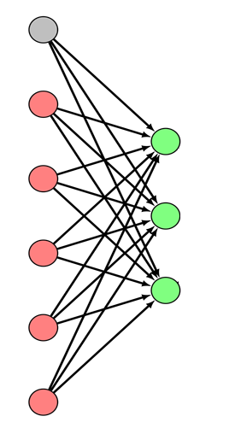


VARIATIONAL AUTO-ENCODERS (VARS)
$$σ$$
SAMPLE
$$μ$$
Photo Credit: https://it.wikipedia.org/wiki/Apprendimento_automatico#/media/File:Feed-forward-perceptron.svg

Slide 24
CNN I/O DIMENSIONS REVIEW

Slide 25



CNN I/O DIMENSIONS REVIEW
$$W$$
The spatial size of the output volume is a function of:
Input Image volume size (W)
Receptive field size of the Convolutional Layer (F)
Stride (S)
Amount of zero padding (P)
The equation is as follows:
$$O= (W−F+2P)/S+1.$$
For example:
With stride = 1, 7x7 input and 3x3 filter, pad = 0, the output will be = 5x5.
With stride = 2, 7x7 input and 3x3 filter, pad = 0, the output will be =3x3.
The formula used to measure the padding value to get the spatial size of the input and output volume to be the same with stride 1:
$P =(F−1)/2$
$$F$$
1 | 0 | 0
0 | 1 | 0
0 | 1 | 0

Slide 26



WHAT’S THE MEANING OF PADDING = ‘SAME’?
Same padding means that the size of output feature map will be similar to the input feature maps (assuming that stride=1).
For example if the input image is 28 x 28, then the output map will be 28 x 28 as well.
$P =\frac{F−1}{2}=\frac{3−1}{2}=1$
0 | 0 | 0
0
0
0 | 0 | 0
 |  | 0
 |  | 0
$$F=3$$
$W$ = 10

Slide 27
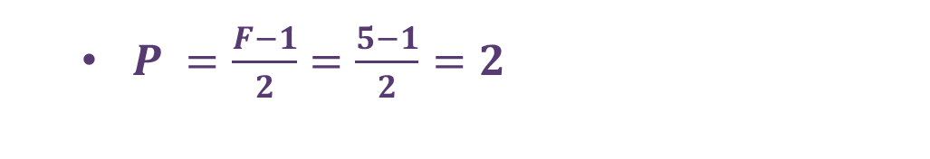


PADDING = ‘SAME’ EXAMPLE
$P =\frac{F−1}{2}=\frac{5−1}{2}=2$
0 | 0 | 0 | 0 | 0
0 | 0 | 0 | 0 | 0
0 | 0
0 | 0
0 | 0
0 | 0 | 0 | 0 | 0
0 | 0 | 0 | 0 | 0
 |  |  | 0 | 0
 |  |  | 0 | 0
 |  |  | 0 | 0
$$F=5$$
$W$ = 10

